Slide 1
Parrot mini-drones & Leap Motion

Slide 2

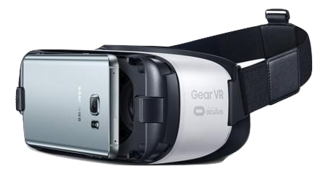

Slide 3
Technologies?
NodeJS
Websockets
JavaScript

Slide 4
Android project
Show and explain your web, app or software projects using these gadget templates.
Place your screenshot here

Slide 5
Thanks!
Any questions?
El Madaleno Manda™

